Slide 1
Midterm Project

Slide 2


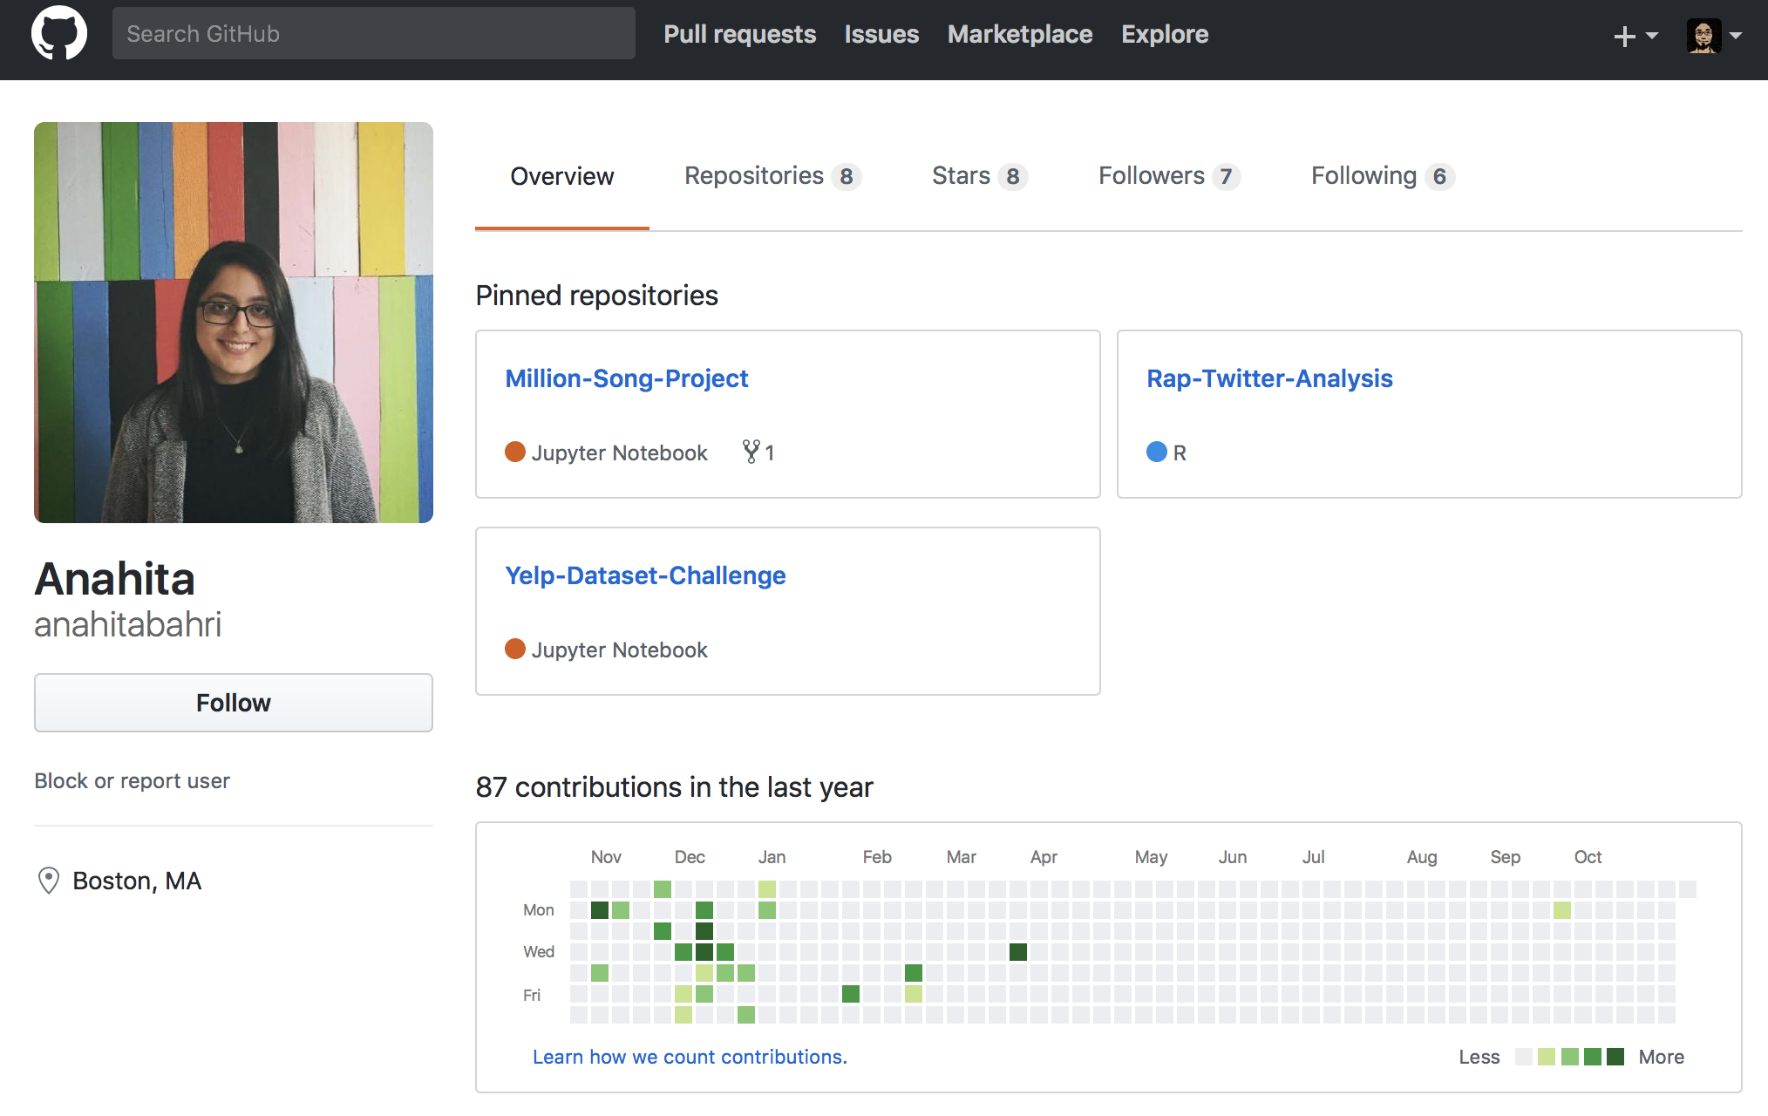

Midterm Project
Data Analysis Project: Choose a (large) dataset (or more) that is relevant for your career goals and display your capabilities for analyzing that includes fitting at least a multilevel model or doing causal inference.

Slide 4
Project Ideas
Criteria:
A “LARGE” dataset with at least 10 groups that’s “Interesting” to compare using multilevel model.
Or a “LARGE” dataset that you can use causal inference technique to infer something new.
Example data:
Tech:
Yelp Data challenge: https://www.yelp.com/dataset
AirBnB: http://insideairbnb.com/get-the-data.html
Consumer:
Customer Revenue prediction: https://www.kaggle.com/c/ga-customer-revenue-prediction
Medical:
Medicare, CDC: https://data.medicare.gov/data/. https://wonder.cdc.gov
Financial:
IMF: http://data.imf.org/?sk=388DFA60-1D26-4ADE-B505-A05A558D9A42
Lending club: https://www.lendingclub.com/info/download-data.action
Music:
Million Songs: https://labrosa.ee.columbia.edu/millionsong/
etc. + extra bonus if you can combine different datasets.

Slide 5
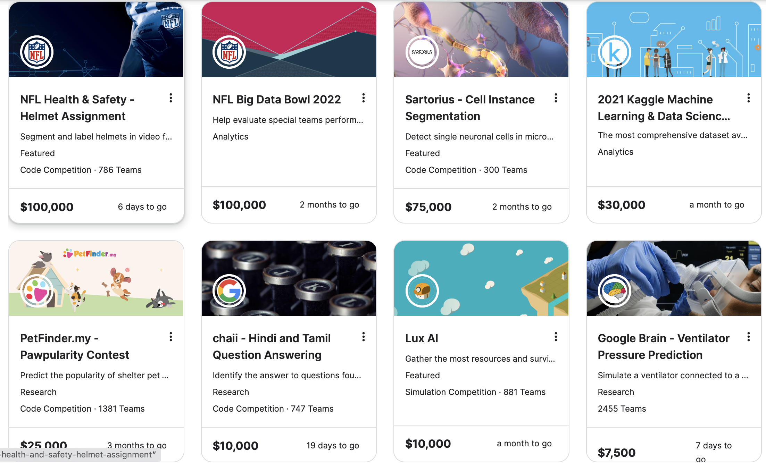
KAGGLE

Slide 6
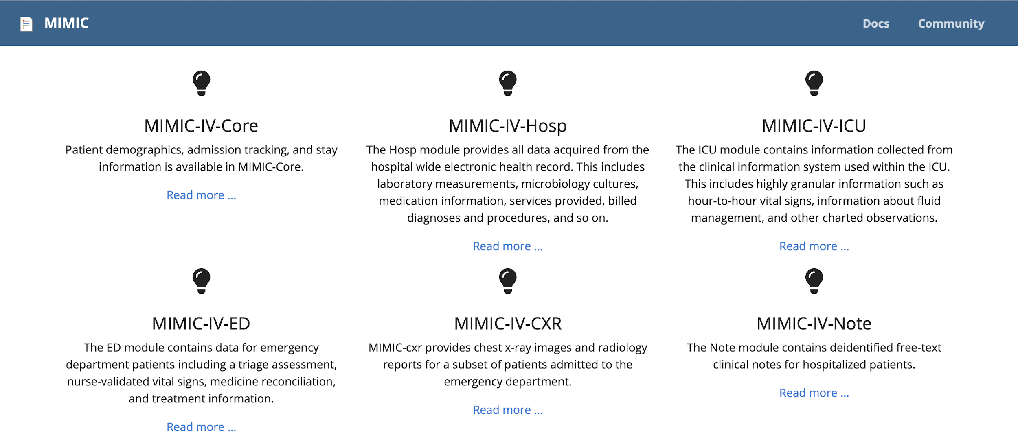
MIMIC

Slide 7
Timeline
11
Nov 9th: Proposal Due
Propose a project that will help you showcase your skills to your future employee.
(Detailed format in the next slide)
Dec 7nd : Recommended submission date
Dec 12th : Final submission date
Recommended Submission 12/7
Recommended Timeline
Partner Projects
Consulting Projects
MA615 Projects
Proposal
11/9
Work
Hard
Thanks Giving
Work
Polish
Deadline
12/12

Slide 8

Grading Rubric for the project
(20) Proposal
(10) Overall Format: Can you confidently show it to a recruiter?
Does it look professional? Is it written in proper language?
(10) Novelty: New in some ways and interesting?
(20) Accuracy: Model choice reasonable? Interpretations correct?
(20) Validation: Detailed model checking to justify the result?
(20) Discussions: Assessment of the result. Limitations? Future directions?
(+10) Technical:
How did you deal with the big data challenge?
Did you integrate data from multiple sources?
(∞) Passion

Slide 9
Proposal Format (max 500 words)
GitHub Repo + 1 Page document + Oral Presentation on Flipgrid
Write up: 1-page online Word document maximum 500 words (10)
Personal Statement: What is your career goal and how this project aligns with the goal.
Question: Preliminary question that you are going to try to answer. (you can change as you see necessary)
The data source (s): Clear link to where you got the data from. If this is your personal data, clearly state what it is.
Proposed Timeline of work: Your tentative plans to finish the following by which date.
EDA:
Data Processing:
Modeling and Validation:
Write up:
Once written, please submit an editable link on the blackboard for grading.
Oral presentation: 1min on Flipgrid. (10)
https://flipgrid.com/0814df6c

Slide 10
Final Submission Format
Submit a nicely formatted PDF and a link to your GitHub repo to the blackboard.
The main report should be at most 5 pages, including figures. (Appendix will not be counted)
Abstract (a paragraph): high-level summary of your work.
Introduction: Background and other information necessary to understand your work.
Method: What you did in some detail.
Result: What you found
Discussion: What you think this means and what are the next steps.
Appendix: (not part of the page limit)
All the supporting results and details that may get in the way of your argument goes here.
Model checking details, figures that are not crucial,
Supplement
Code, etc
Please do not show raw R output in your report.

Slide 11
Learning from and working with others
You may discuss your work with other people.
But you are to each submit your own original work.
We will check the originality of your work. You will get no point if
You have significant overlap in the content with someone from the class.
You have copied more than 20 percent of your text from some online source.
Please note that if you are doing Kaggle competition, copying other people’s work without attribution is not allowed.
The screening will be done automatically. If your report is flagged as concerning and if you cannot prove your innocence, I will ask you to redo the work using other data from scratch.
If you fail to submit this report, you will get an incomplete for the class.
We have had challengers that copied from online work, TA, classmate, etc. All of them were caught. Please do not make me have to report you to the GRS.

Slide 12
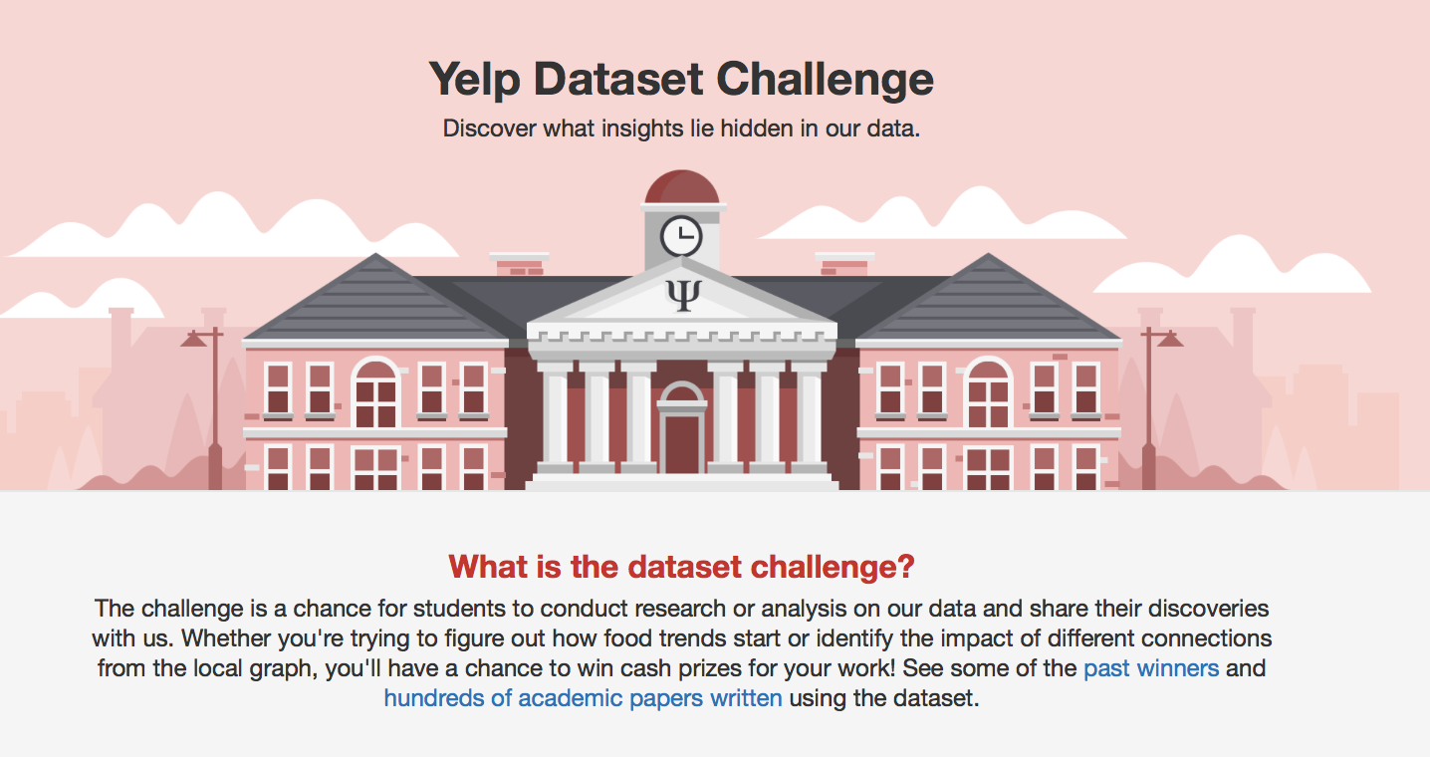
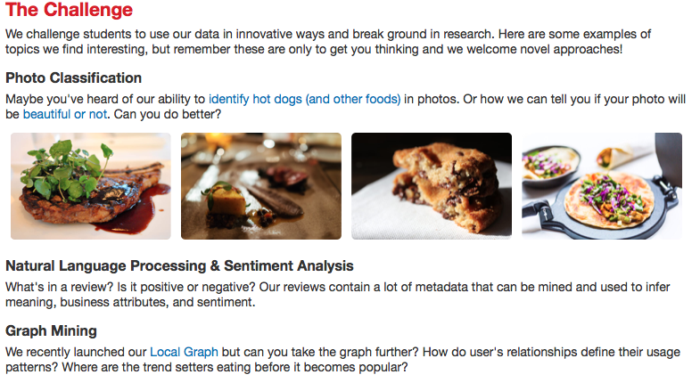
Yelp Data Challenge
The 13th installment
https://www.yelp.com/dataset/challenge

Slide 13
Public Datasets • https://github.com/awesomedata/awesome-public-datasets • https://github.com/apiad/datasets-list • https://github.com/datasets/openml-datasets/tree/master/data the same data as this list https://www.openml.org/search?type=data • https://archive.ics.uci.edu/ml/datasets.html • https://www.data.gov/ • https://www.kaggle.com/datasets • http://datamob.org/ • https://sites.google.com/a/drwren.com/wmd/details • https://data.cityofnewyork.us/data • http://snap.stanford.edu/data/index.html • http://aws.amazon.com/datasets/

Slide 14
Event Data • GeoLife GPS Trajectories http://research.microsoft.com/en-us/downloads/b16d359d-d164- 469e-9fd4-daa38f2b2e13/ • Activity Recognition in the Home Setting Using Simple and Ubiquitous Sensors (MIT Project 2004) http://courses.media.mit.edu/2004fall/mas622j/04.projects/home/ • https://sites.google.com/a/drwren.com/wmd/home Frequent Itemset Mining Dataset Repository • http://fimi.ua.ac.be/data/ Airline On-time Performance • http://www.eecs.wsu.edu/~yyao/StreamingGraphs.html • http://openflights.org/data.html Collection and Streaming of Graph Datasets • http://www.eecs.w su.edu/~yyao/StreamingGraphs.html Data Streams • http://www.quora.com/Where-can-I-find-public-or-free-real-time-or-streaming-data-sources • 3 hourly weather forecast and observational data - UK locations http://data.gov.uk/dataset/metoffice_uklocs3hr_fc • There is also an IRC chan with the live log of wikipedia edits on the #en.wikipedia channel of the irc.wikimedia.org server. http://blog.programmableweb.com/2010/12/26/64-new-apis-realtime- facebook-twitter-streaming-and-google-shopping/

Slide 15
New York Taxi Datasets • https://data.ny.gov/ • TLC Trip Record Data http://www.nyc.gov/html/tlc/html/about/trip_record_data.shtml http://www.nyc.gov/html/tlc/html/about/trip_record_data.shtml • Another set published by chris whong http://chriswhong.com/open-data/foil_nyc_taxi/ this data set is used for the DEBS 2015 challenge http://www.debs2015.org/call-grand-challenge.html • Another Description of this dataset http://publish.illinois.edu/dbwork/open-data/ OpenStreet Map • http://wiki.openstreetmap.org/wiki/Planet.osm Dublin Bus GPS sample data from Dublin City Council (Insight Project) • https://data.gov.ie/dataset/dublin-bus-gps-sample-data-from-dublin-city-council-insight-project Further data set at https://data.gov.ie Wikipedia Dump • Wikpedia Dump https://dumps.wikimedia.org/ Amazon Review Data Downloader • https://github.c om/aesuli/Amazon-downloader

